Slide 1
Group 27
IS 436 Section 02- Structured Systems Analysis and Design
Deliverable 5
Bryan Baek, Brendan Bessel, Kalabe Mulugeta, Josiah Tillett, Xinbo Yang

Slide 2
A short bio of Aviation Port Service
Aviation Port Services, L.L.C. was formed in the 3rd quarter of 2007 given an opportunity to fill a void in service left at both Oakland and San Diego International airports. We began operations handling both Passenger and Ramp services for a very progressive Airbus narrow body aircraft operator. We had the experience, equipment and financial backing to exceed the level of service of our competitors and begin operations in October of the same year. We quickly earned respect of the industry with consistent on-time performance, outstanding customer service and a fair and competitive price point of our services.
-APS Website
Problem:
Develop a system that would automate the daily timekeeping of employees as well as provide a direct deposit alternative to paychecks.

Slide 3
Functional Requirements of the New System (Part 1)
Report Generation - Process Oriented
The system will generate a daily report that will allow managers to evaluate when an employee has punched in or out
The system will generate a report at the end of the pay period that will allow the manager to see how many regular, overtime, and holiday hours each employee has worked
Employee Search - Process Oriented
The system must allow the manager to search for an employee based on name
The system must allow the manager to search for an employee based on SS number
The system must allow the manager to search for an employee based on Employee number
Edit - Process Oriented
The system must allow the manager to manually edit an employee’s, personal information schedule, hours worked, and punch times

Slide 4
Functional Requirements of the New System (Part 2)
4. Report Storage - Information Oriented
The system will store all generated reports
The system will store manually entered information
5. Clock In/Out - Process Oriented
The system must allow employees to clock in or out
The system will display “view time to date” for employees to know how many hours the have worked during the pay period.
System will flag late employees and add their accumulated late minutes to the daily report
System will flag managers when employees are late
6. Manager Creates Schedule - Process Oriented
System must allow manager to input schedule into time-keeping system

Slide 5
What Alternative was chosen to complete the Project

Slide 6
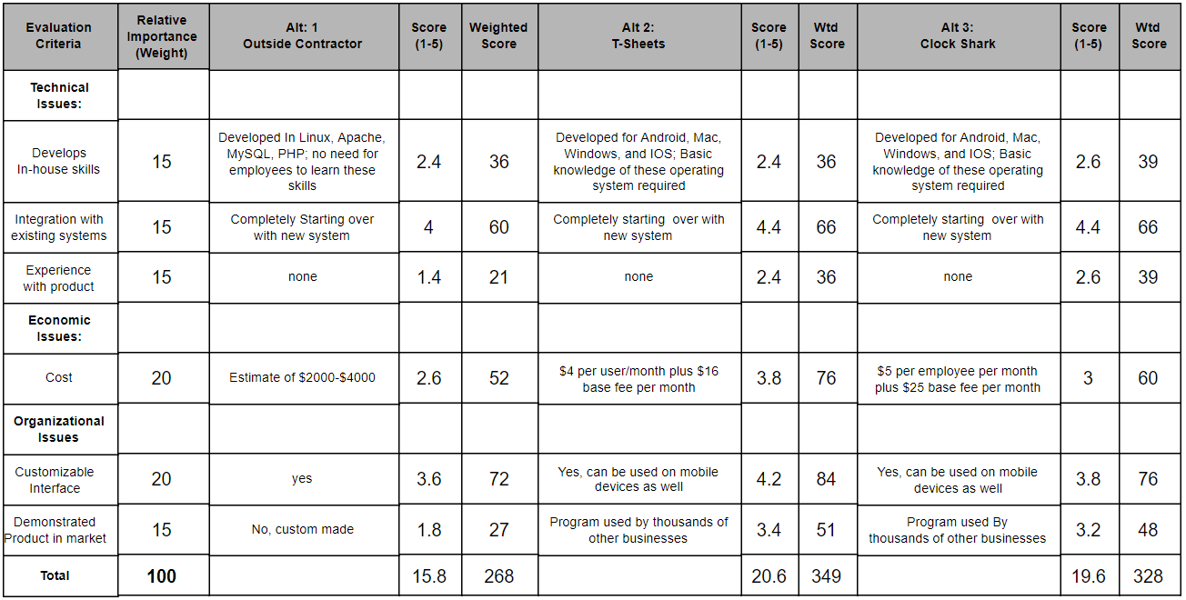
T-sheet

Slide 7
Physical Level 0 DFD
Tools used:
mySQL
PHP
Html
java

Slide 8
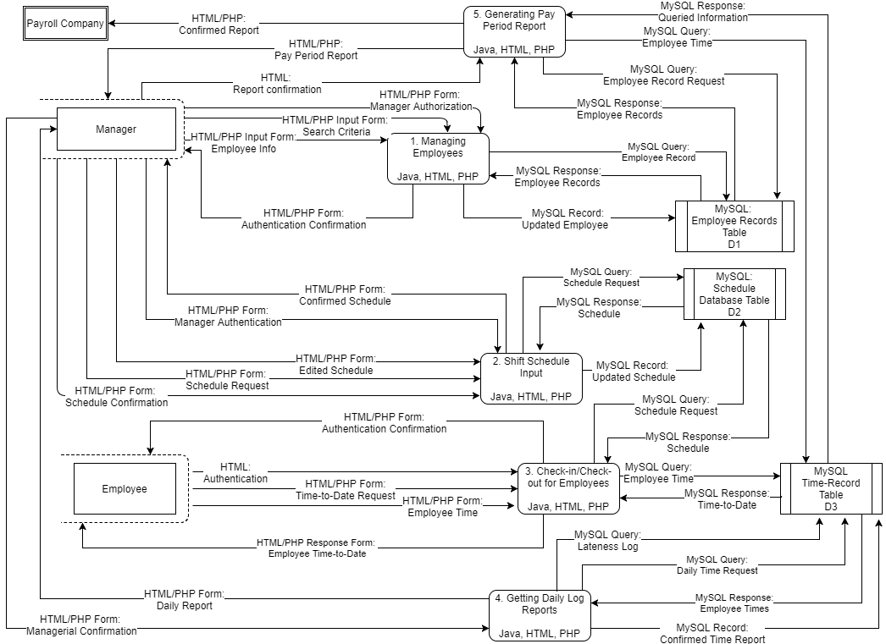

Slide 9
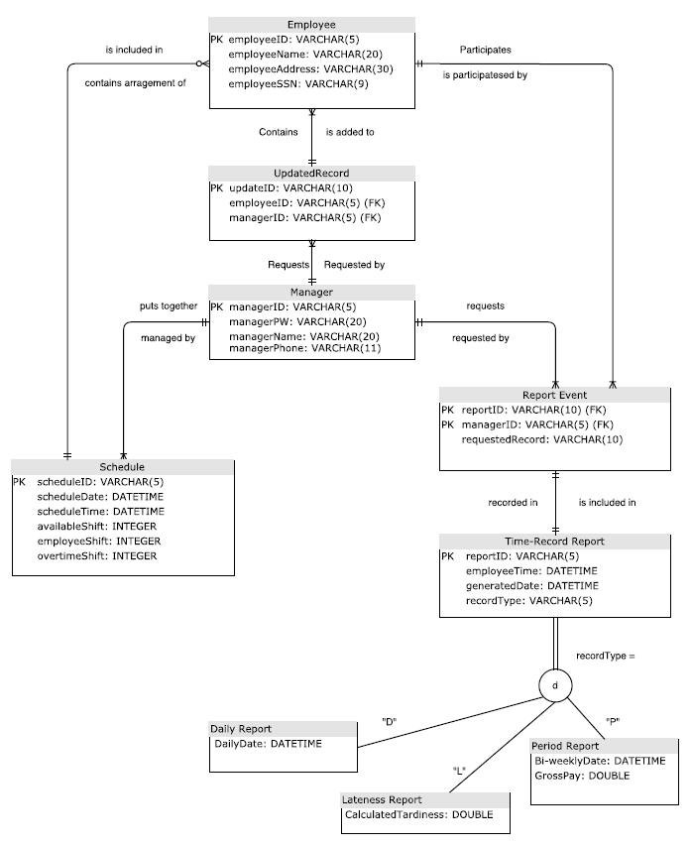
The Physical ERD

Slide 10
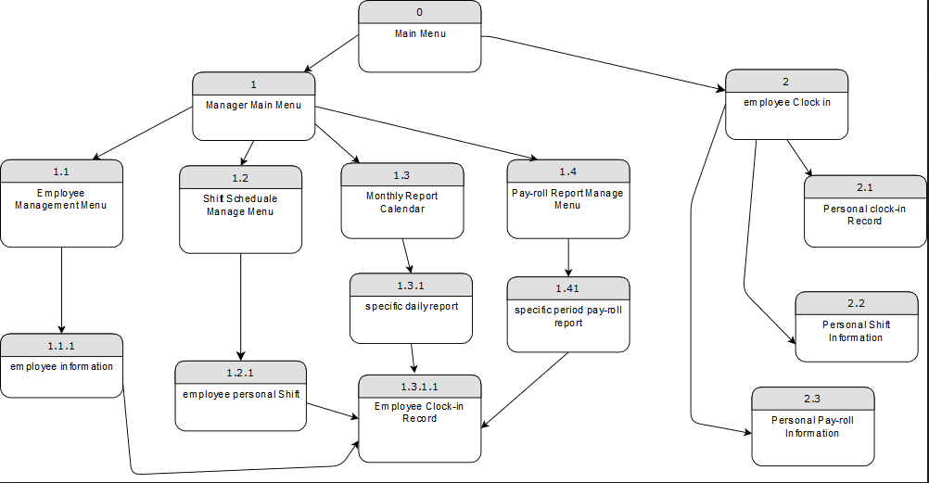
The Interface Structure Diagram

Slide 11
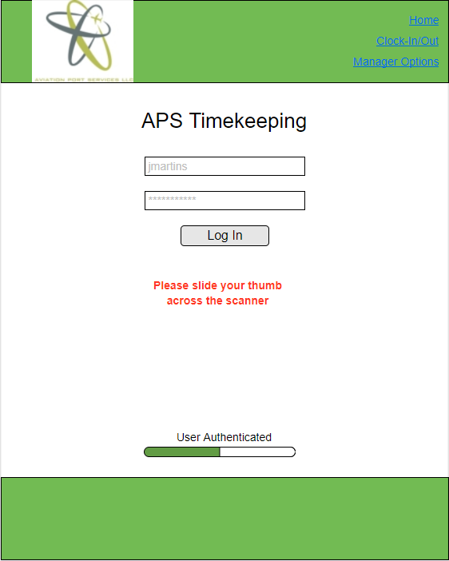
Layout of Three Screens #1
Authentication Pt. 2

Slide 12
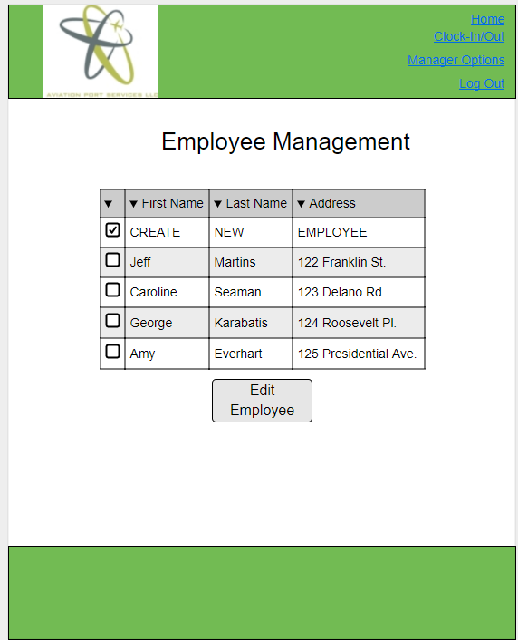
Layout of Three Screens #2
Employee Management - Selection

Slide 13
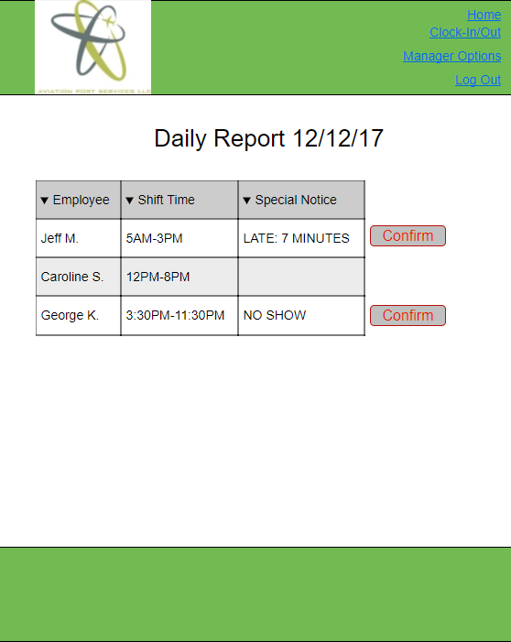
Layout of Three Screens #3
Daily Report - Selection

Slide 14
Limitations and Solutions
Limitation:
Getting a detailed description of what languages were being used by the software vendor we chose was difficult due to time constraints. The company wanted us to wait for them to draft an NDA and has yet to get back to us.
Solution:
We had to use prior knowledge to make an educated guess on what tools would be used to develop a similar app.
Limitation:
The legacy system that was used was difficult to integrate and improve, especially when we do not have much experience with
customization and an outsource contractor.
Solution:
We found a mature package product that will be able to satisfy all requirements..

Slide 15
Lessons Learned
Bryan Baek - Communication is very important when working on the group project. It is also important to include the user and sponsor about any update made
Brendan Bessel - Company-wide problems can be broken down into smaller more manageable pieces and software vendors exist just to handle these very specific functions.
Kalabe Mulugeta - Lots of up-front work was required to get the project rolling. Always be prepared to have to get your hands dirty to get a project going.
Josiah Tillett - Communication is key. Always overestimate deadlines, that way you end up coming in on time when you get delays.
Xinbo Yang - let user actively participate during developing process can save a lot of cost. Mobile platform can be either solution or cause of problem

Slide 16
Thank you
(Questions?)

